Slide 1


Machine Learning for Neuroscience
Transformers
Payam Barnaghi
Department of Brain Sciences
Imperial College London
Spring 2023
The main content are adapted from: Ch. 12, Understanding Deep Learning, Simon J.D. Prince, MIT Press.
Notes:
1

Slide 2
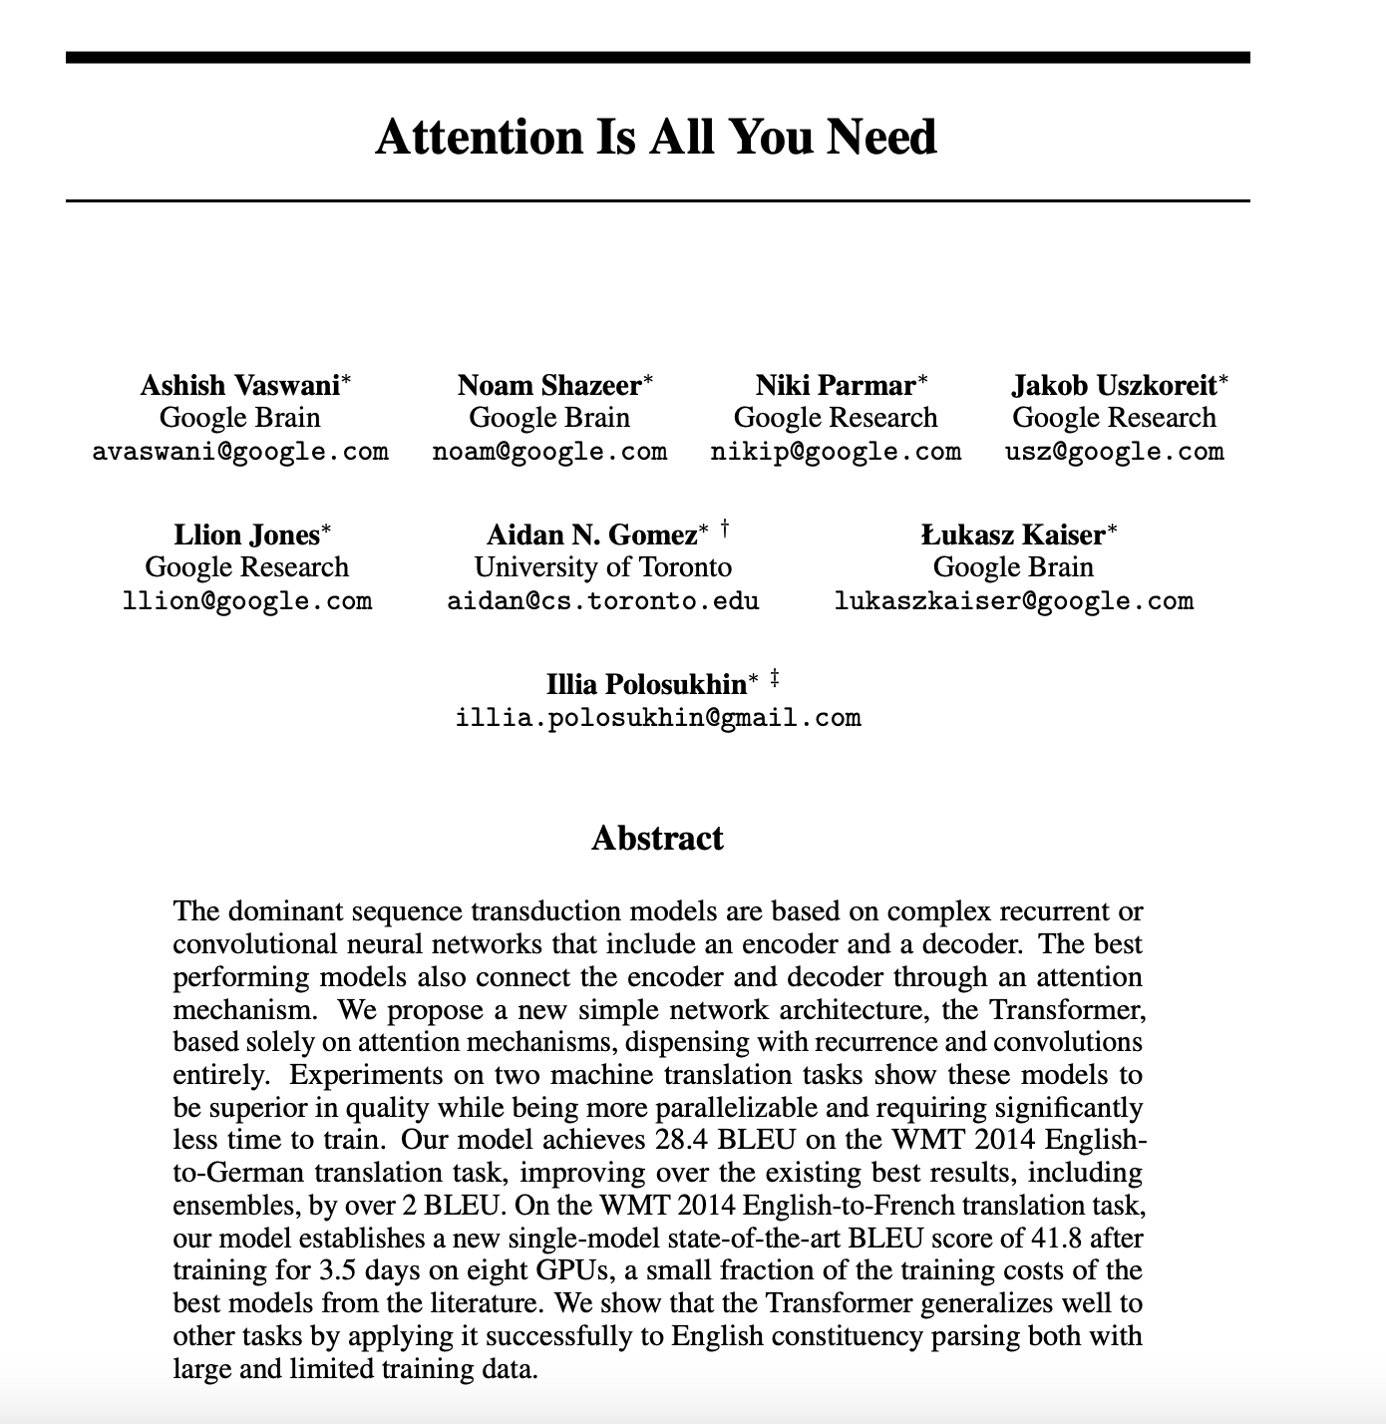

Slide 3

Attention
Main link:: https://www.youtube.com/watch?v=xNSgmm9FX2s
Via: https://www.youtube.com/watch?v=48gBPL7aHJY&t=0s

Slide 4

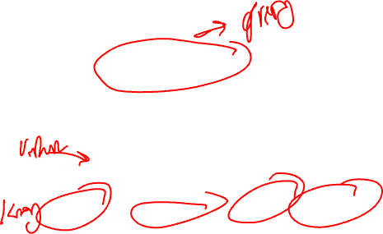
Query, key and value

Slide 5

Self-attention
After arriving in London Paddington didn’t know where to go. The streets were busy and there was traffic jam everywhere. So he went to the Paddington station and had his favourite jam sandwich.

Slide 6



Attention (also requires context)

Slide 7

Selective attention
Image source: TripAdvisor

Slide 8

Multi-head self-attention

Slide 9
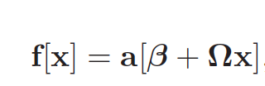
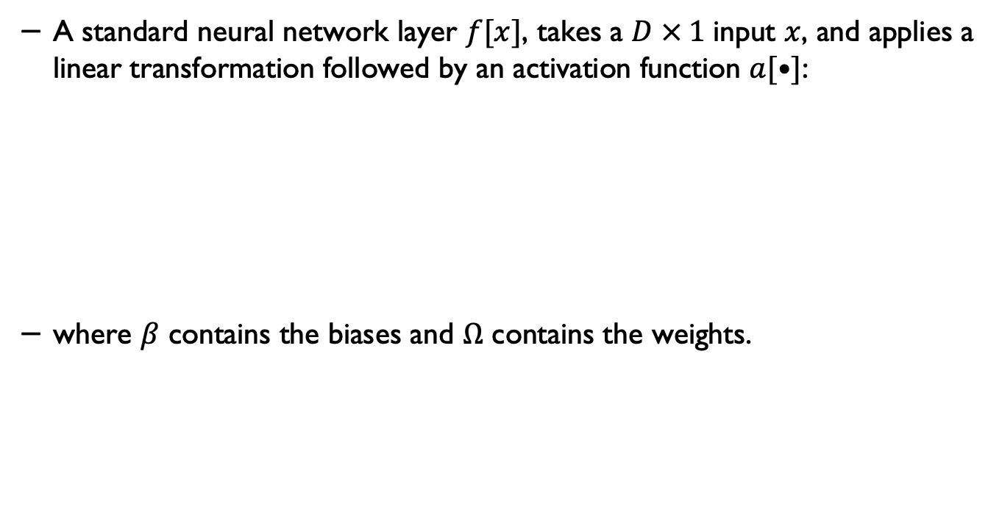
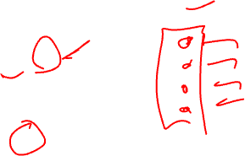
Standard neural networks
A standard neural network layer $f[x]$, takes a $D × 1$input $x$, and applies a linear transformation followed by an activation function $a[•]$:
where $β$ contains the biases and $Ω$ contains the weights.

Slide 10
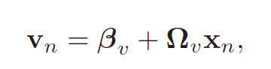
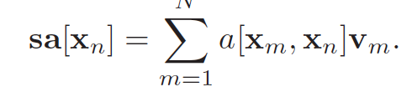
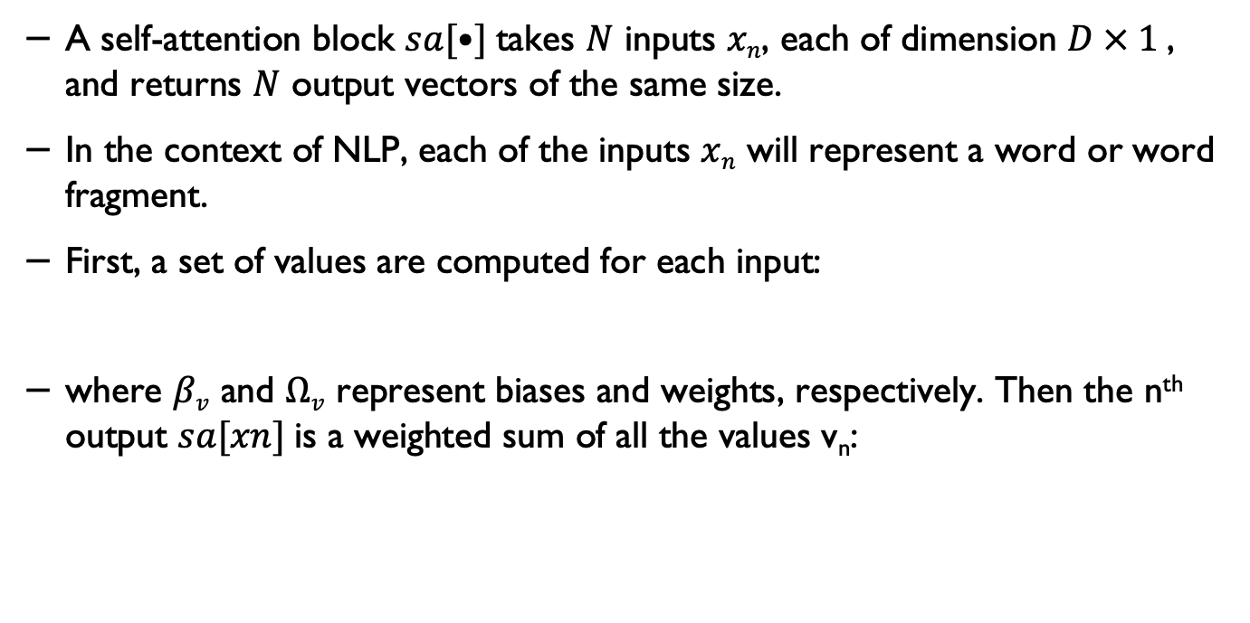
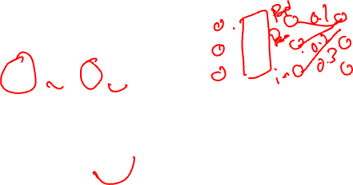
An self-attention network
A self-attention block $sa[•]$takes $N$ inputs $xn$, each of dimension $D × 1$, and returns $N$ output vectors of the same size.
In the context of NLP, each of the inputs $xn$ will represent a word or word fragment.
First, a set of values are computed for each input:
where $βv$ and $Ωv$ represent biases and weights, respectively. Then the n^{th} output $sa[xn]$is a weighted sum of all the values v_{n}:
Understanding Deep Learning, Simon J.D. Prince, MIT Press.

Slide 11
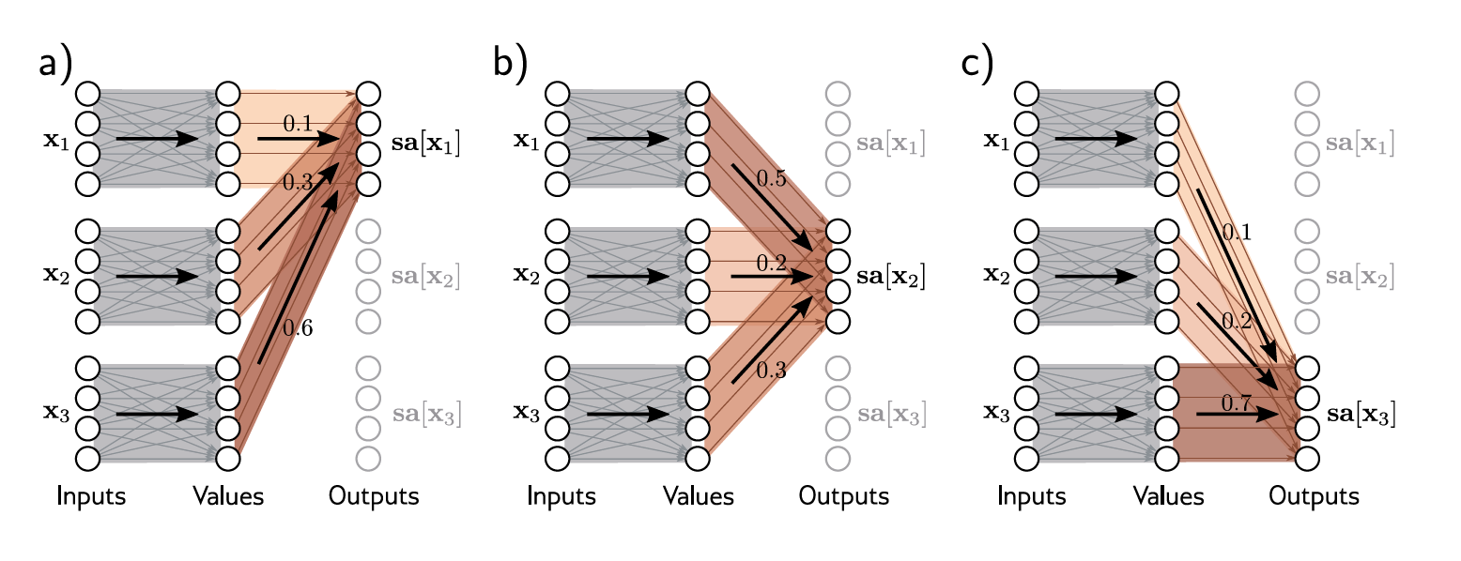
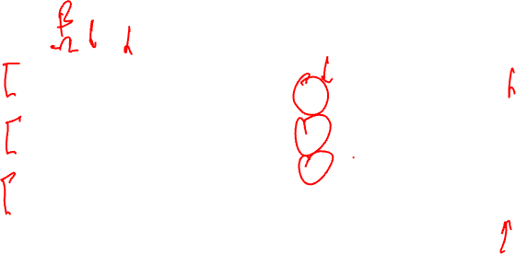
Self-attention
Understanding Deep Learning, Simon J.D. Prince, MIT Press.

Slide 12
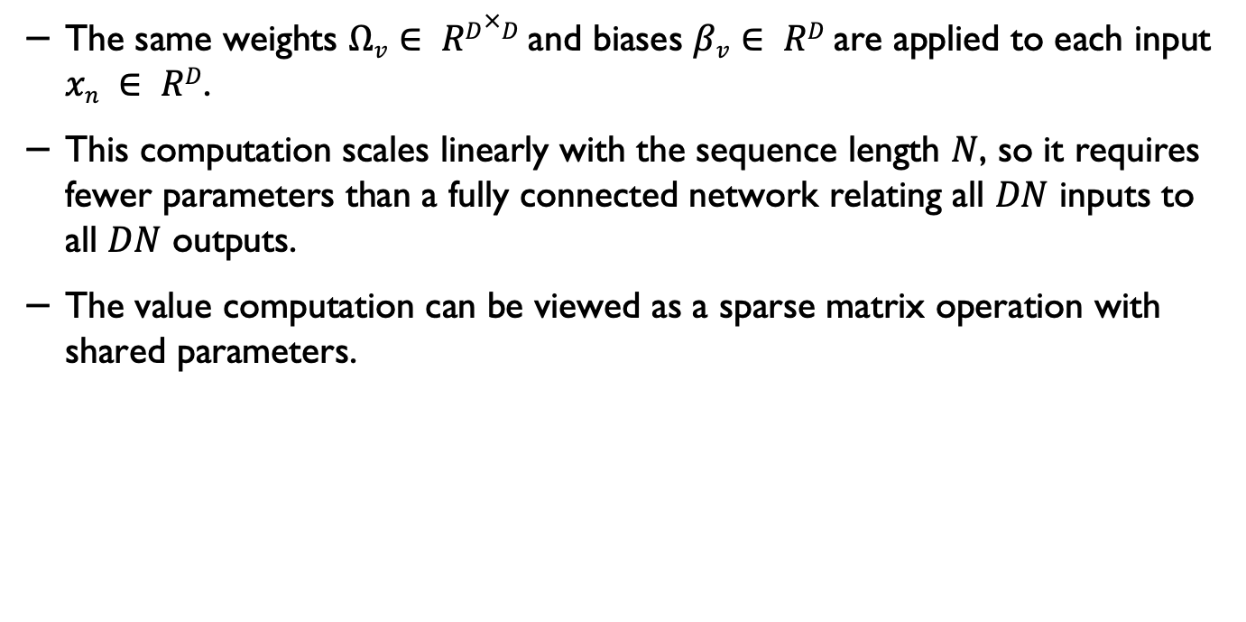
Computing the weights
The same weights $Ωv∈ RD×D$and biases $βv∈ RD$are applied to each input $xn ∈ RD$.
This computation scales linearly with the sequence length $N$, so it requires fewer parameters than a fully connected network relating all $DN$ inputs to all $DN$ outputs.
The value computation can be viewed as a sparse matrix operation with shared parameters.

Slide 13
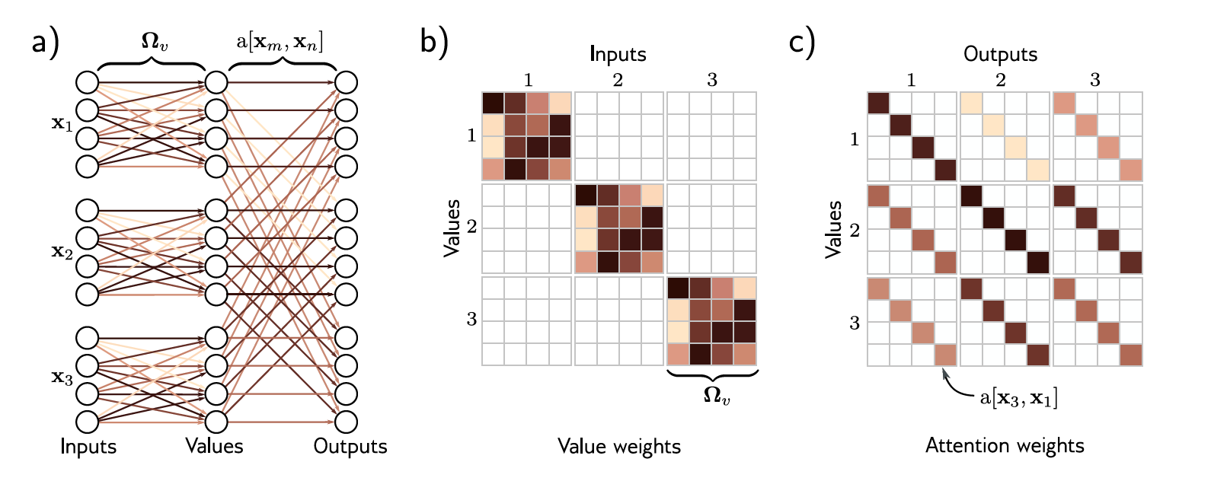
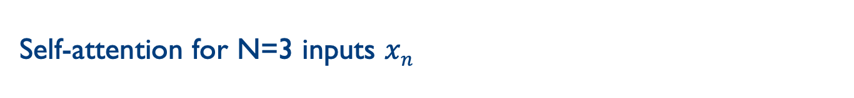
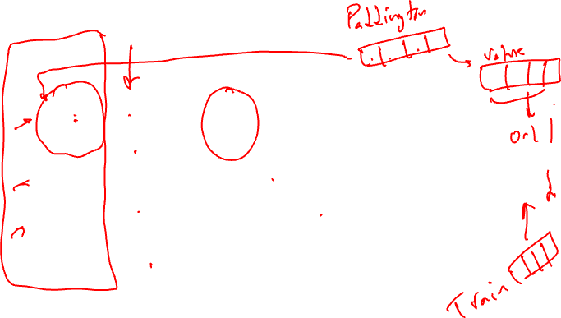
Self-attention for N=3 inputs $xn$
Understanding Deep Learning, Simon J.D. Prince, MIT Press.

Slide 14
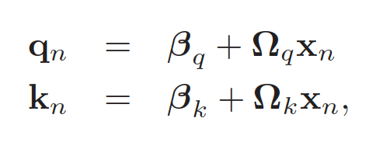
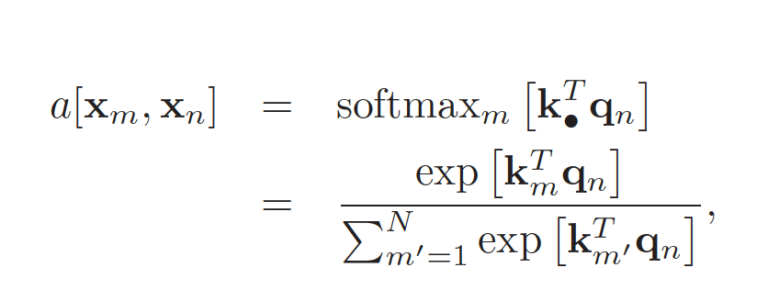
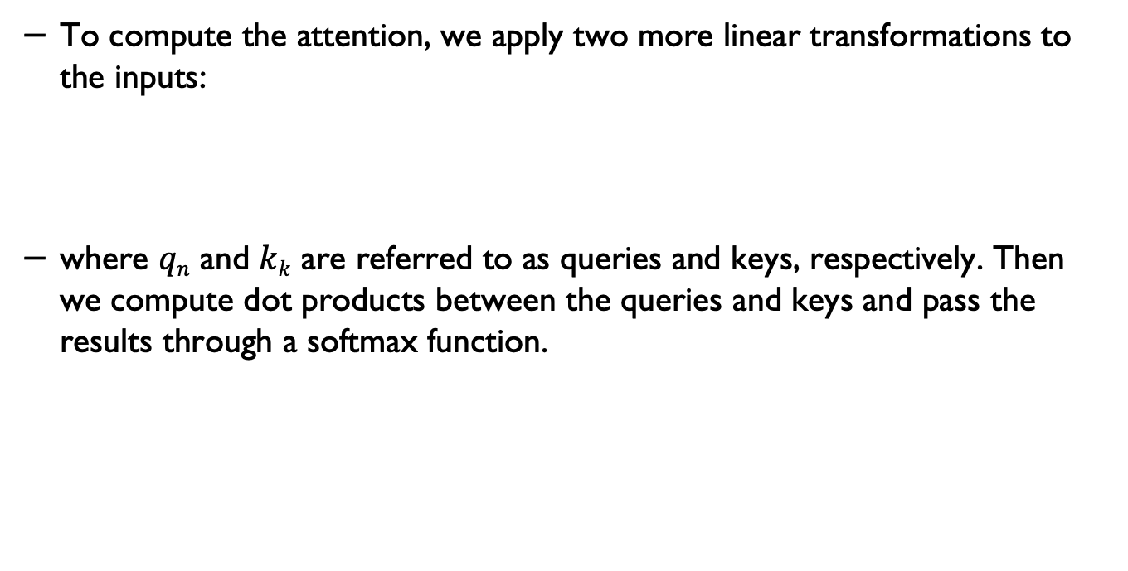
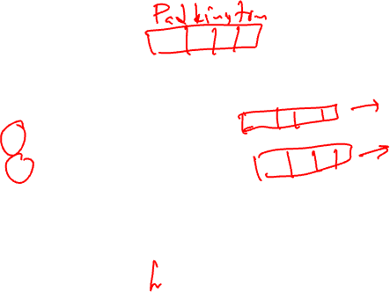
Computing attention weights
To compute the attention, we apply two more linear transformations to the inputs:
where $qn$ and $kk$ are referred to as queries and keys, respectively. Then we compute dot products between the queries and keys and pass the results through a softmax function.

Slide 15
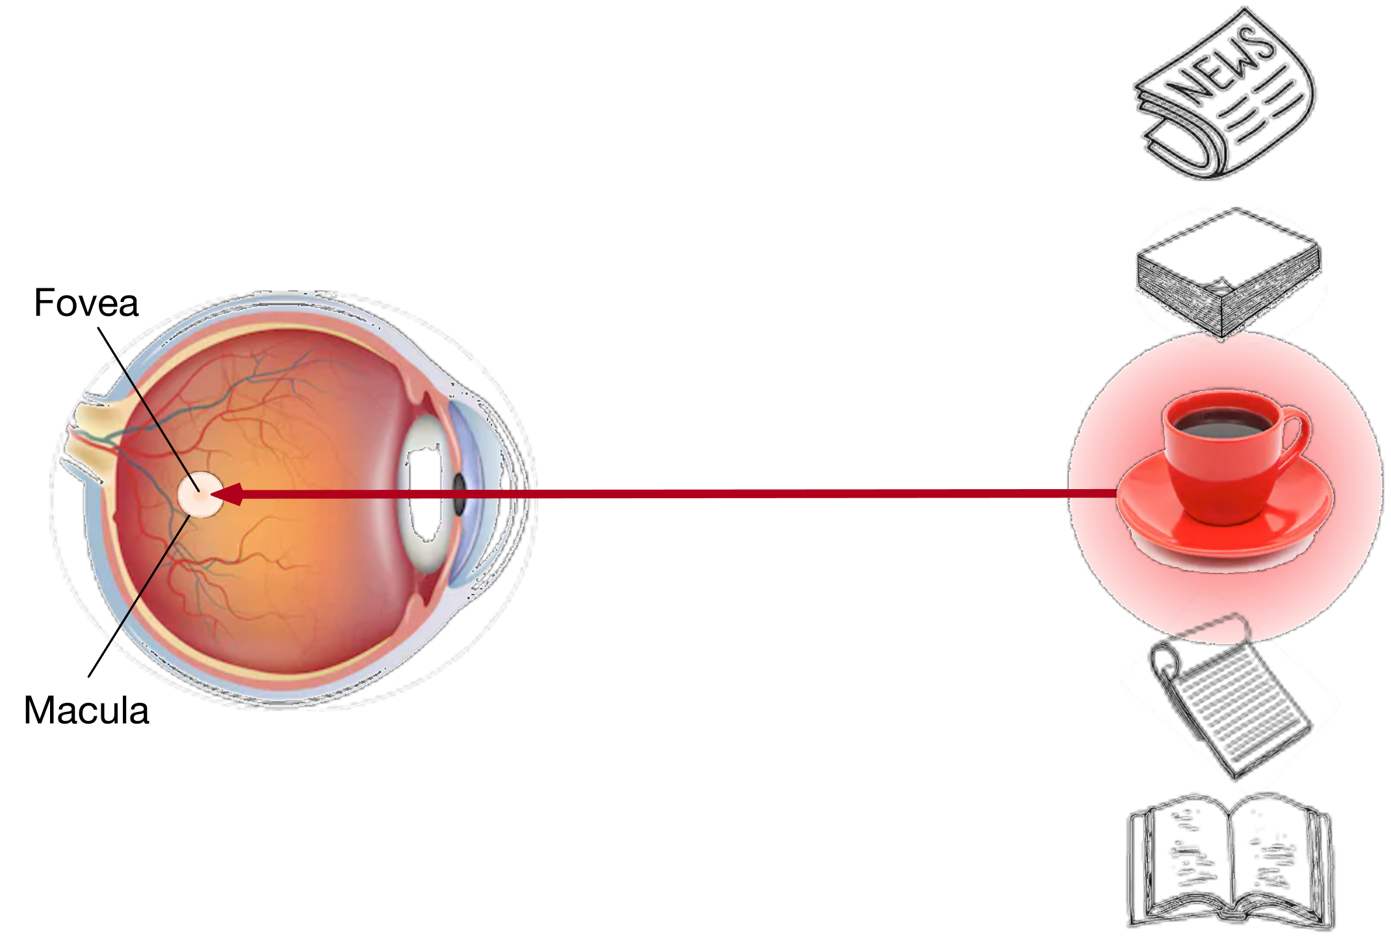
Attention Cues in Biology
Using the nonvolitional cue based on saliency (red cup, non-paper), attention is involuntarily directed to the coffee.
https://d2l.ai/chapter_attention-mechanisms/attention-cues.html

Slide 16
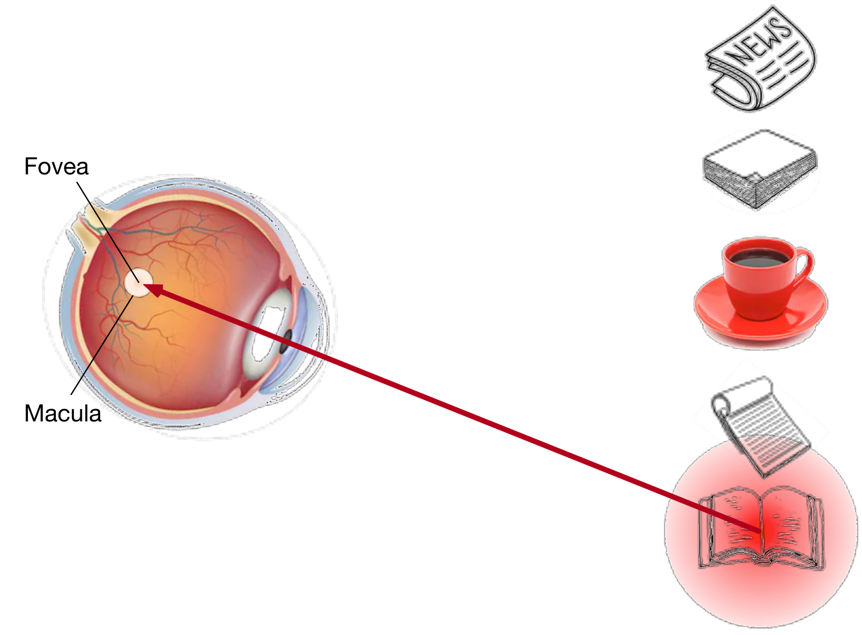
Attention Cues in Biology
Using the volitional cue (want to read a book) that is task-dependent, attention is directed to the book under volitional control.
https://d2l.ai/chapter_attention-mechanisms/attention-cues.html

Slide 17
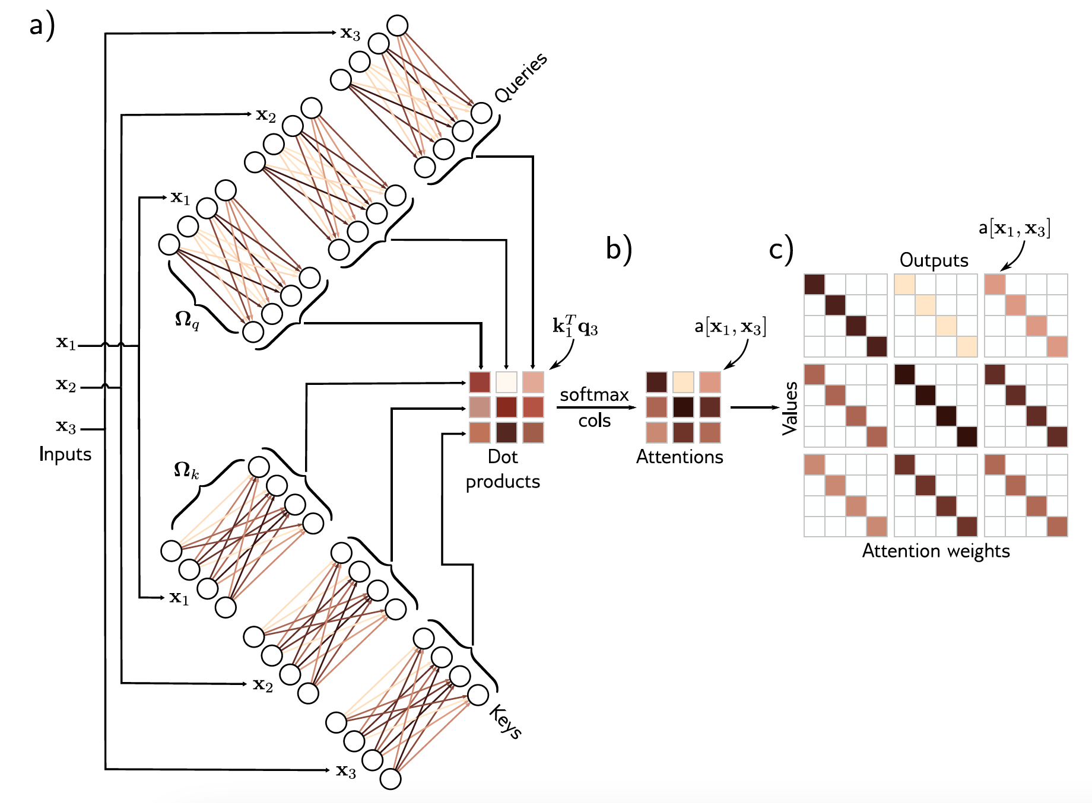
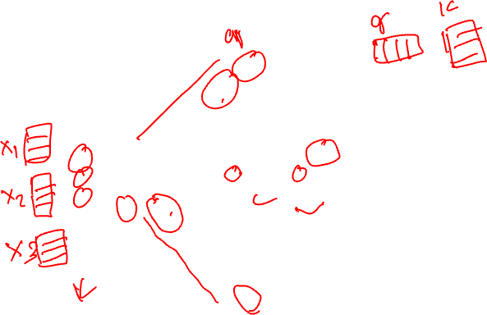
Computing attention weights
Understanding Deep Learning, Simon J.D. Prince, MIT Press.

Slide 18
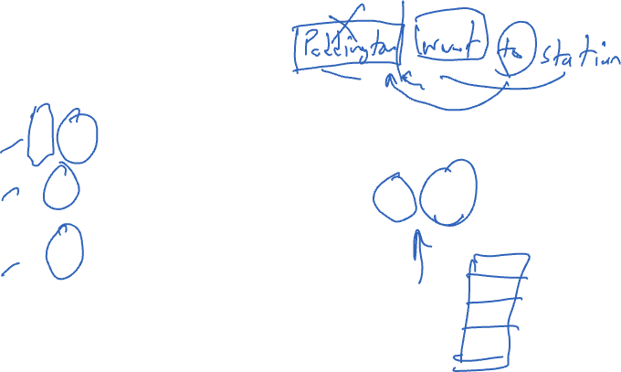
Self-attention for N=3 inputs $xn$
Understanding Deep Learning, Simon J.D. Prince, MIT Press.

Slide 19
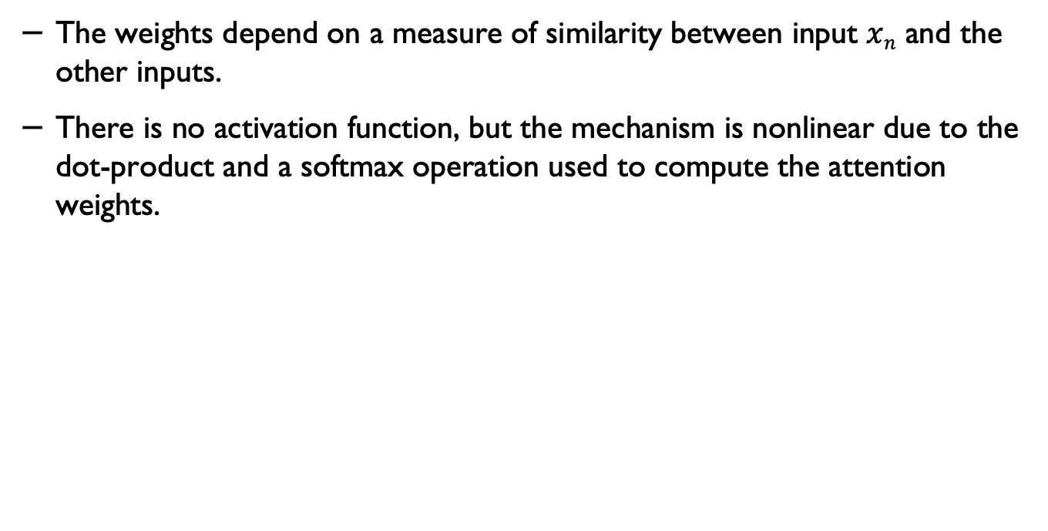
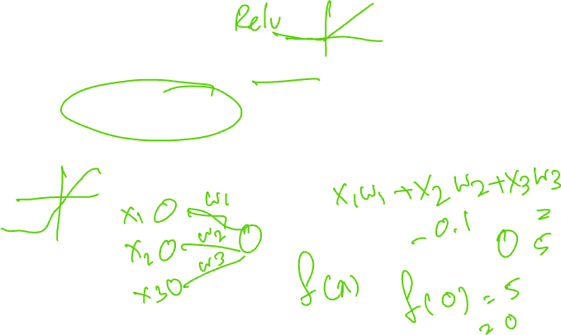
Self-attention
The weights depend on a measure of similarity between input $xn$ and the other inputs.
There is no activation function, but the mechanism is nonlinear due to the dot-product and a softmax operation used to compute the attention weights.

Slide 20
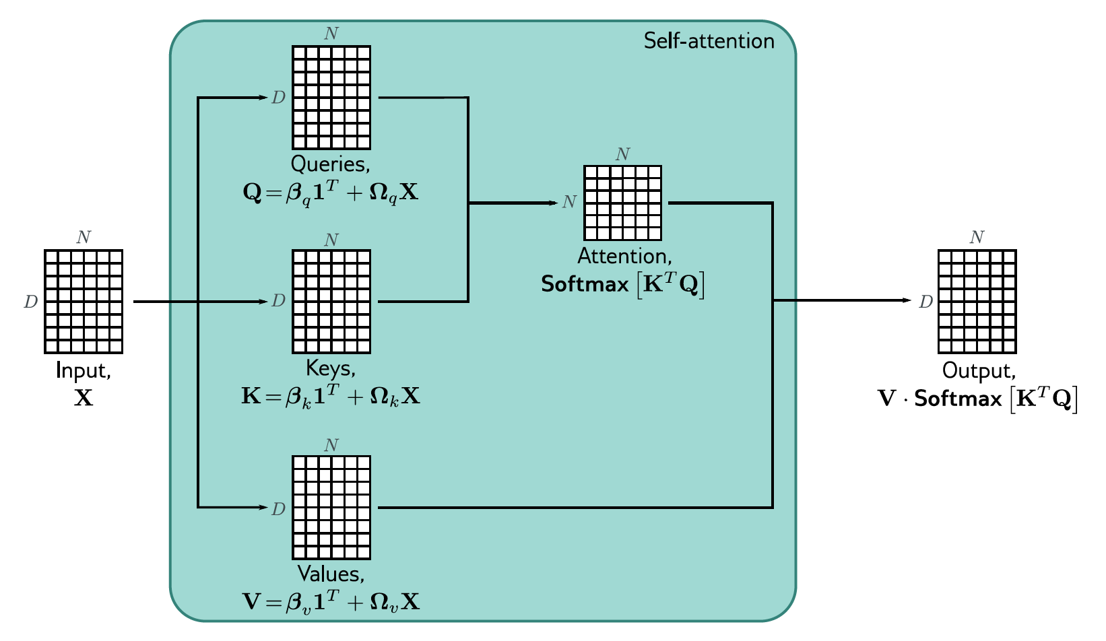
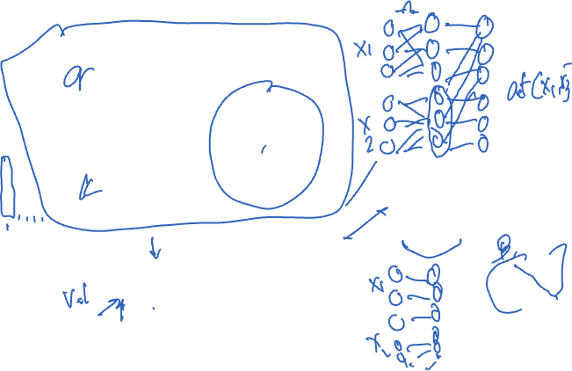
Self-attention in matrix form

Slide 21
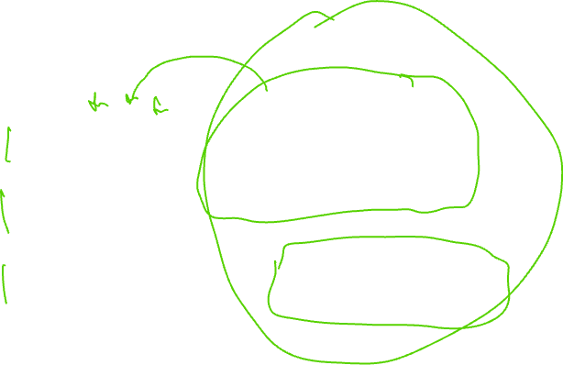
Self-attention for N=3 inputs $xn$
Understanding Deep Learning, Simon J.D. Prince, MIT Press.

Slide 22
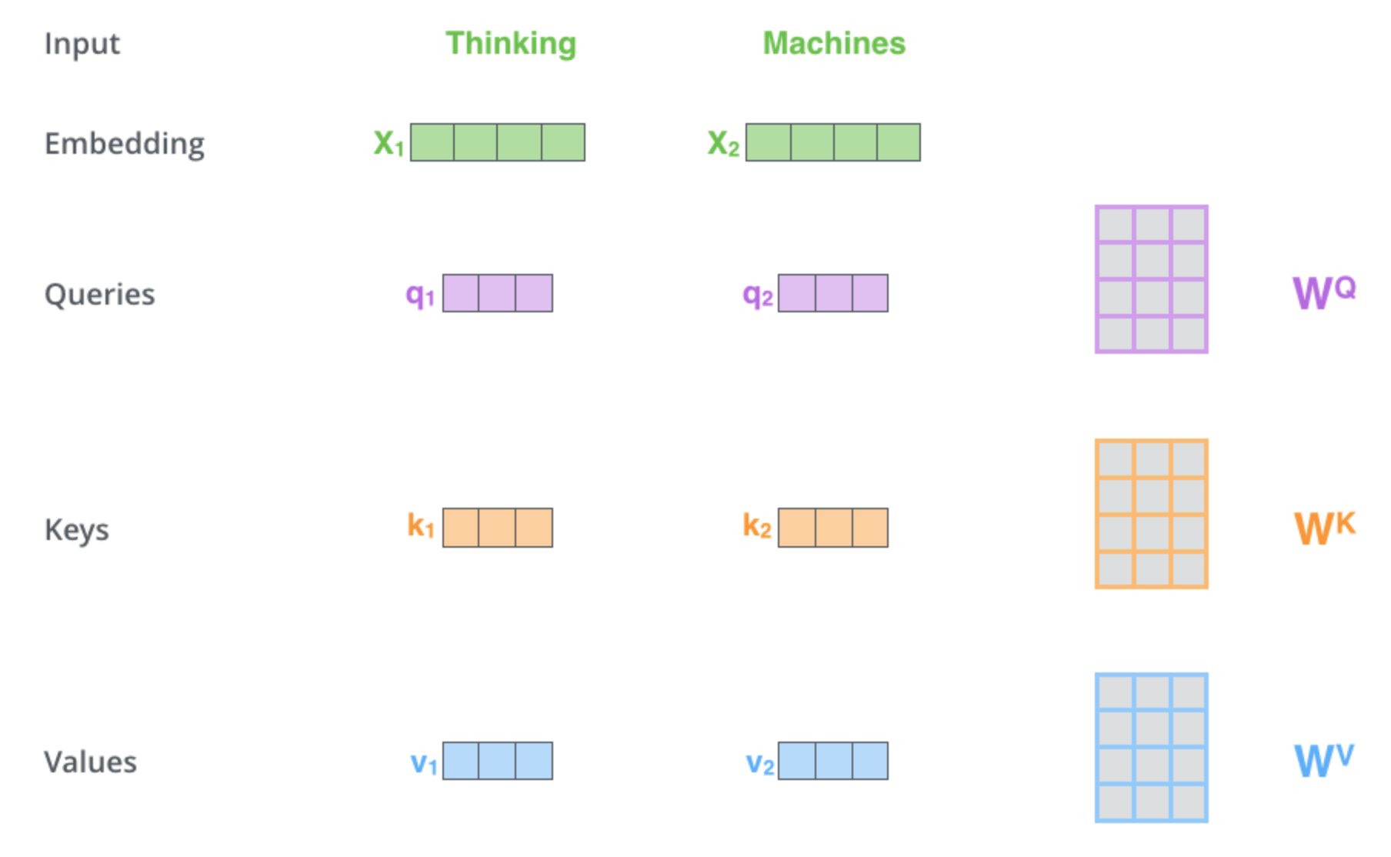

Self-attention: variables
Jay Alammar, The Illustrated Transformer, https://jalammar.github.io/illustrated-transformer/

Slide 23
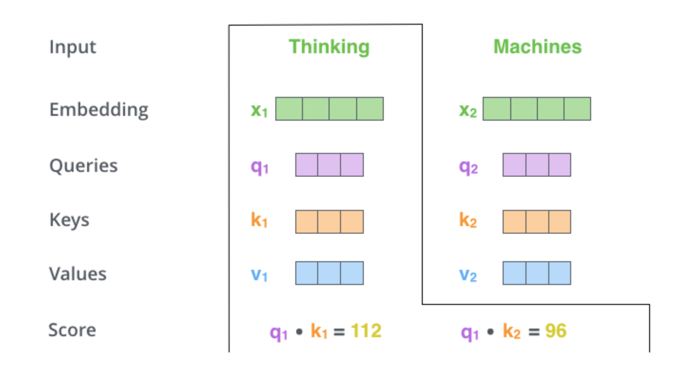
Self-attention: scores
Jay Alammar, The Illustrated Transformer, https://jalammar.github.io/illustrated-transformer/

Slide 24
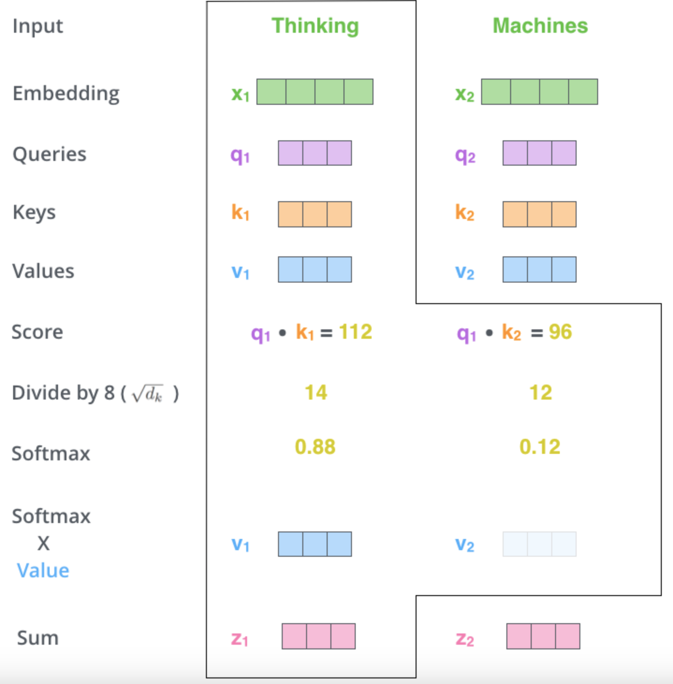

Self-attention: scores + softmax
Jay Alammar, The Illustrated Transformer, https://jalammar.github.io/illustrated-transformer/

Slide 25
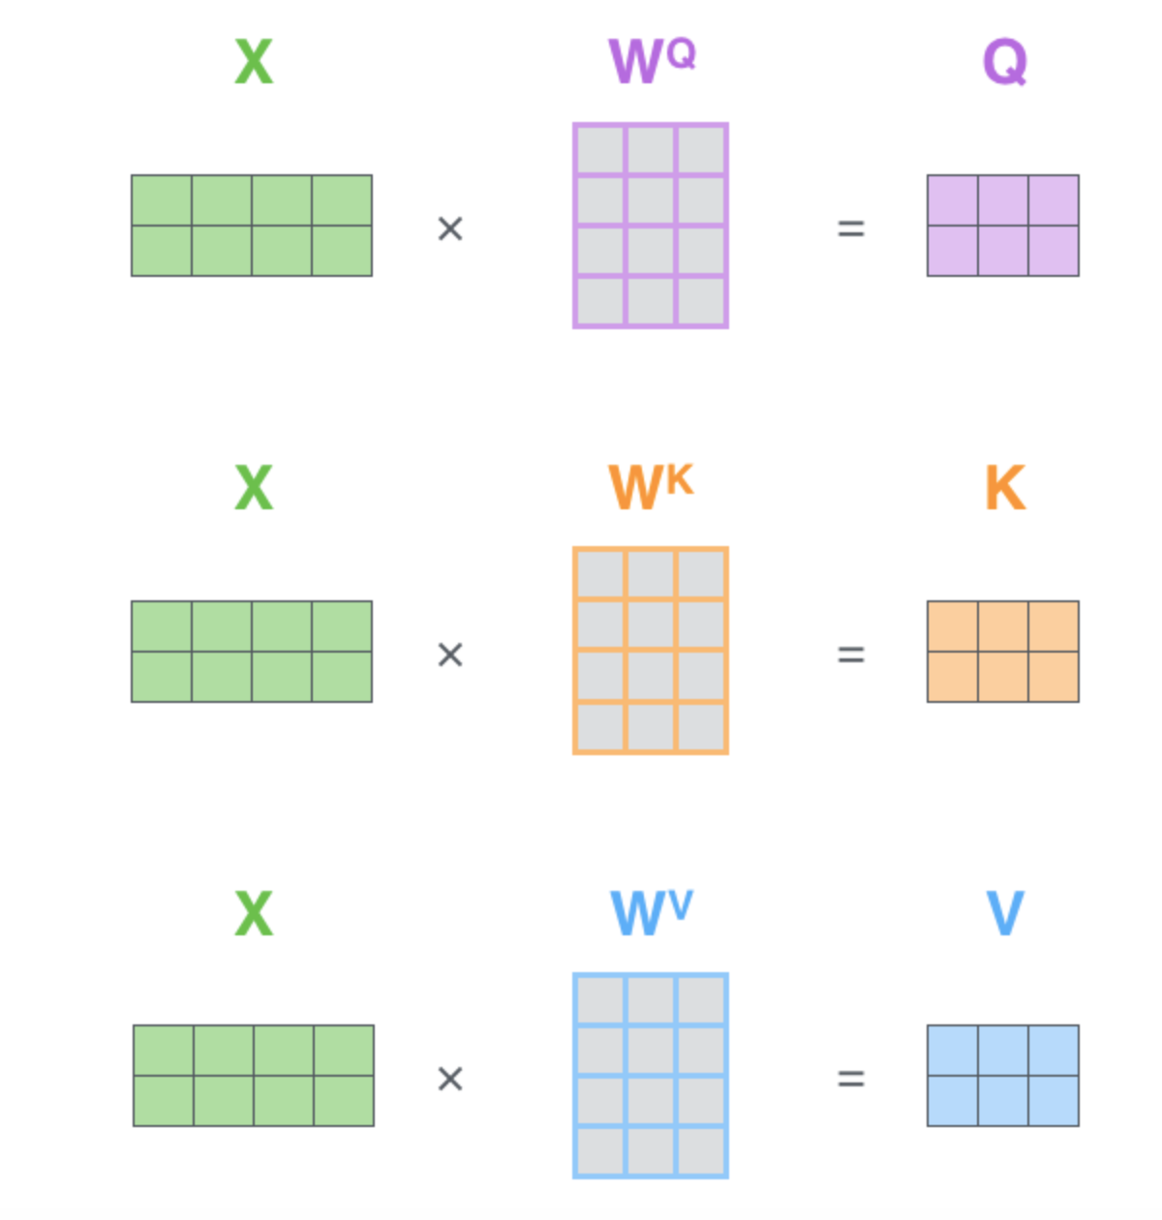
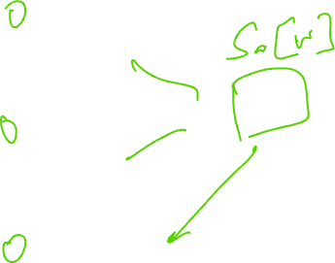
Self-attention: matrix form
Jay Alammar, The Illustrated Transformer, https://jalammar.github.io/illustrated-transformer/

Slide 26
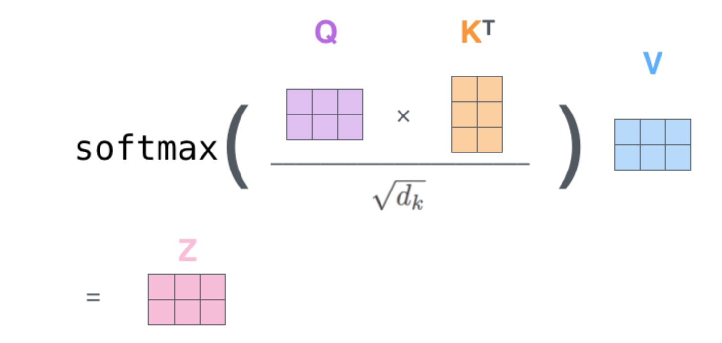
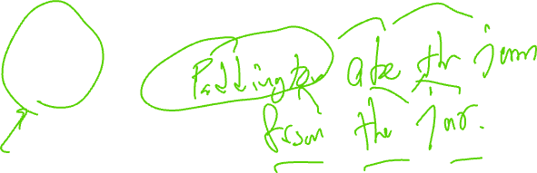
Self-attention: matrix form – z variable
Jay Alammar, The Illustrated Transformer, https://jalammar.github.io/illustrated-transformer/

Slide 27
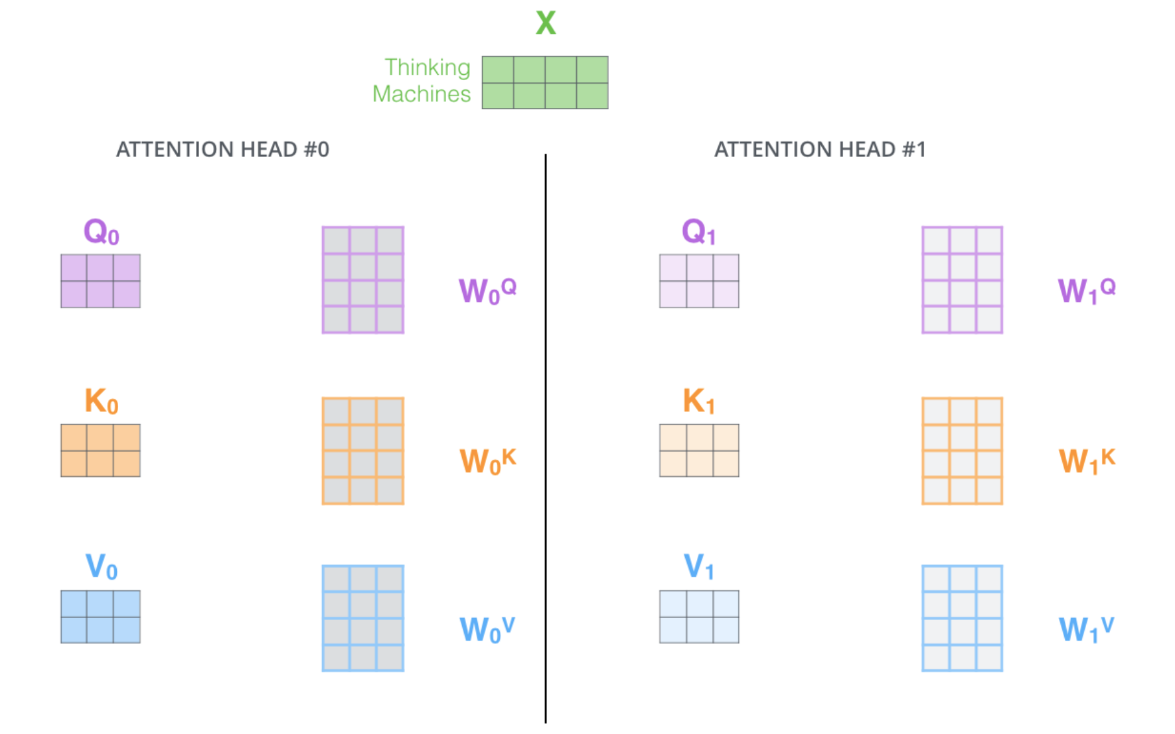
Self-attention: multi heads
Jay Alammar, The Illustrated Transformer, https://jalammar.github.io/illustrated-transformer/

Slide 28
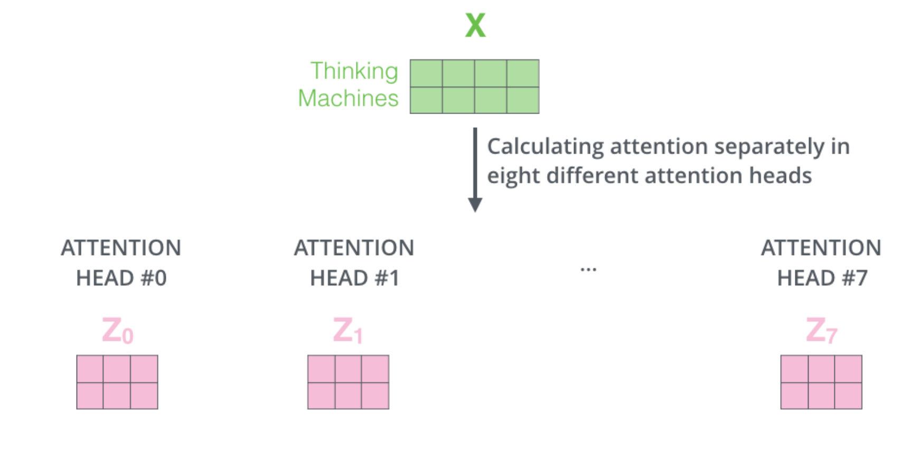
Separate attention heads
Jay Alammar, The Illustrated Transformer, https://jalammar.github.io/illustrated-transformer/

Slide 29
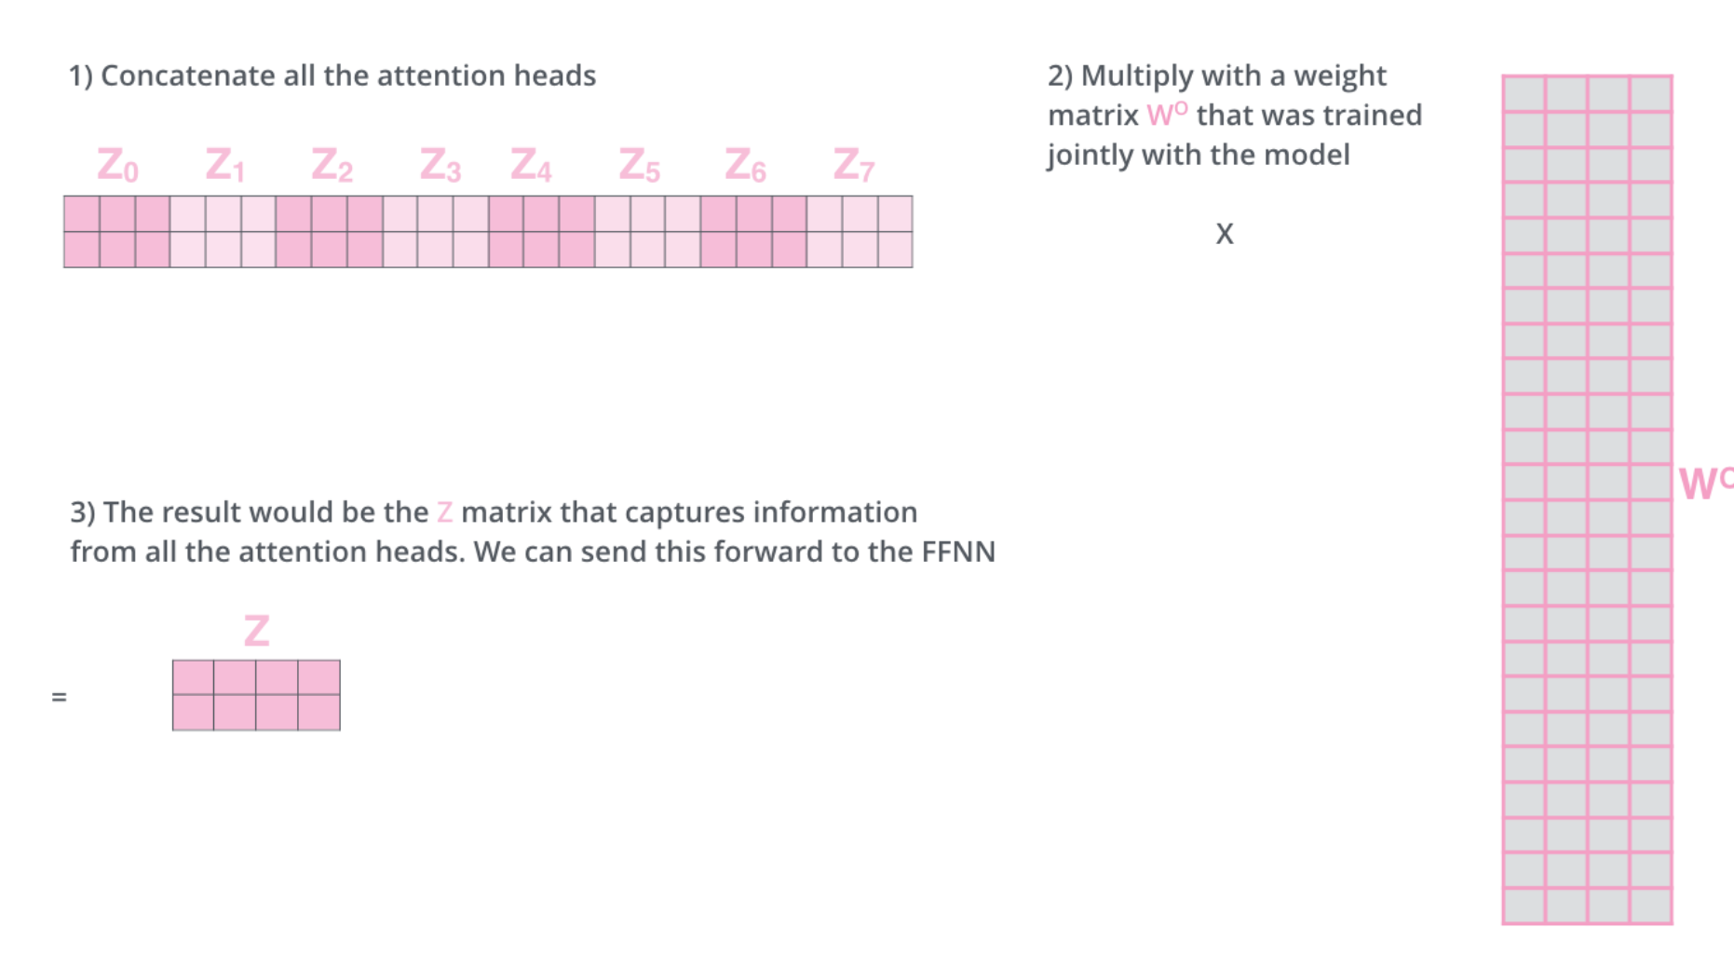
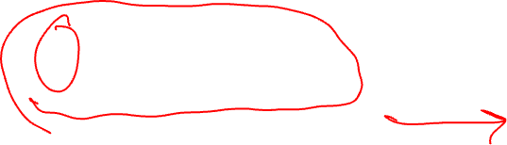
Information from all attention heads
Jay Alammar, The Illustrated Transformer, https://jalammar.github.io/illustrated-transformer/

Slide 30
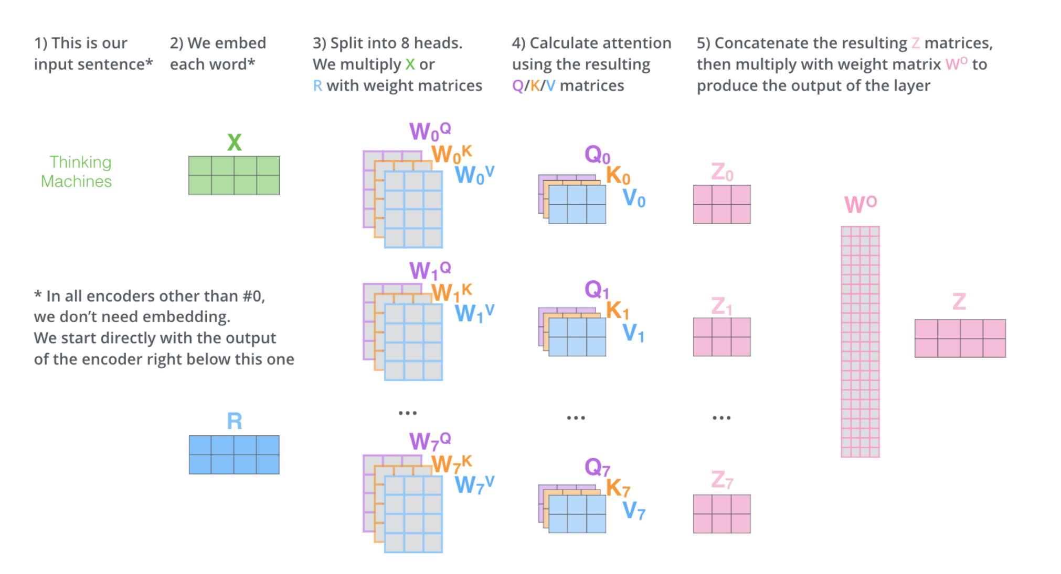
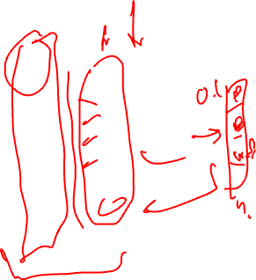
Self-attention: all in one
Jay Alammar, The Illustrated Transformer, https://jalammar.github.io/illustrated-transformer/

Slide 31
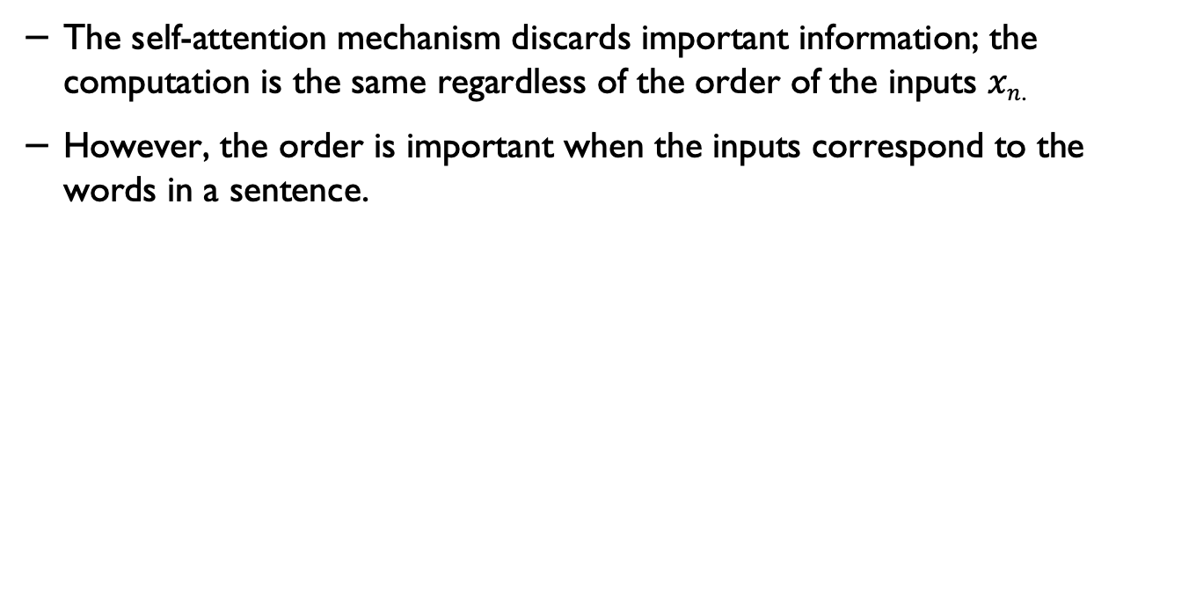
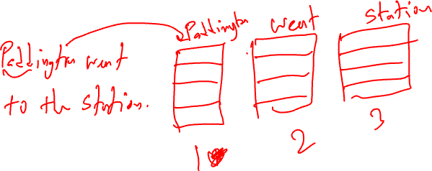
Positional encoding
The self-attention mechanism discards important information; the computation is the same regardless of the order of the inputs $xn$.
However, the order is important when the inputs correspond to the words in a sentence.

Slide 32
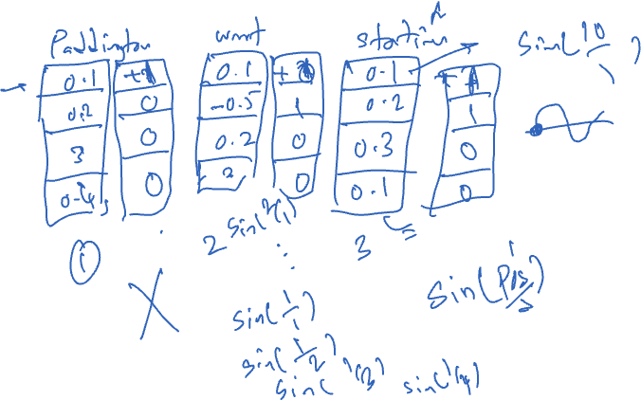
Bag of words

Slide 33
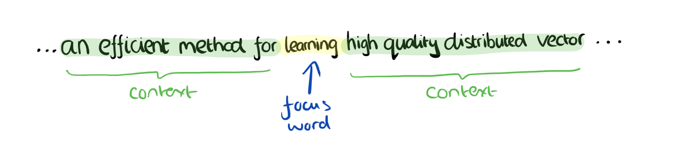
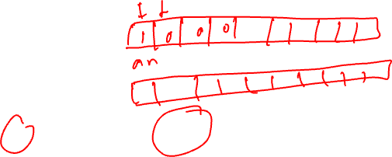
Word2Vec
Adrian Colyer, The amazing power of word vectors, https://blog.acolyer.org/2016/04/21/the-amazing-power-of-word-vectors/

Slide 34
Word2Vec - CBOW
The training objective is to maximise the conditional probability of observing the actual output word (the focus word) given the input context words, with regard to the weights.
In this example, given the input (“an”, “efficient”, “method”, “for”, “high”, “quality”, “distributed”, “vector”) we want to maximise the probability of getting “learning” as the output.
Adrian Colyer, The amazing power of word vectors, https://blog.acolyer.org/2016/04/21/the-amazing-power-of-word-vectors/

Slide 35
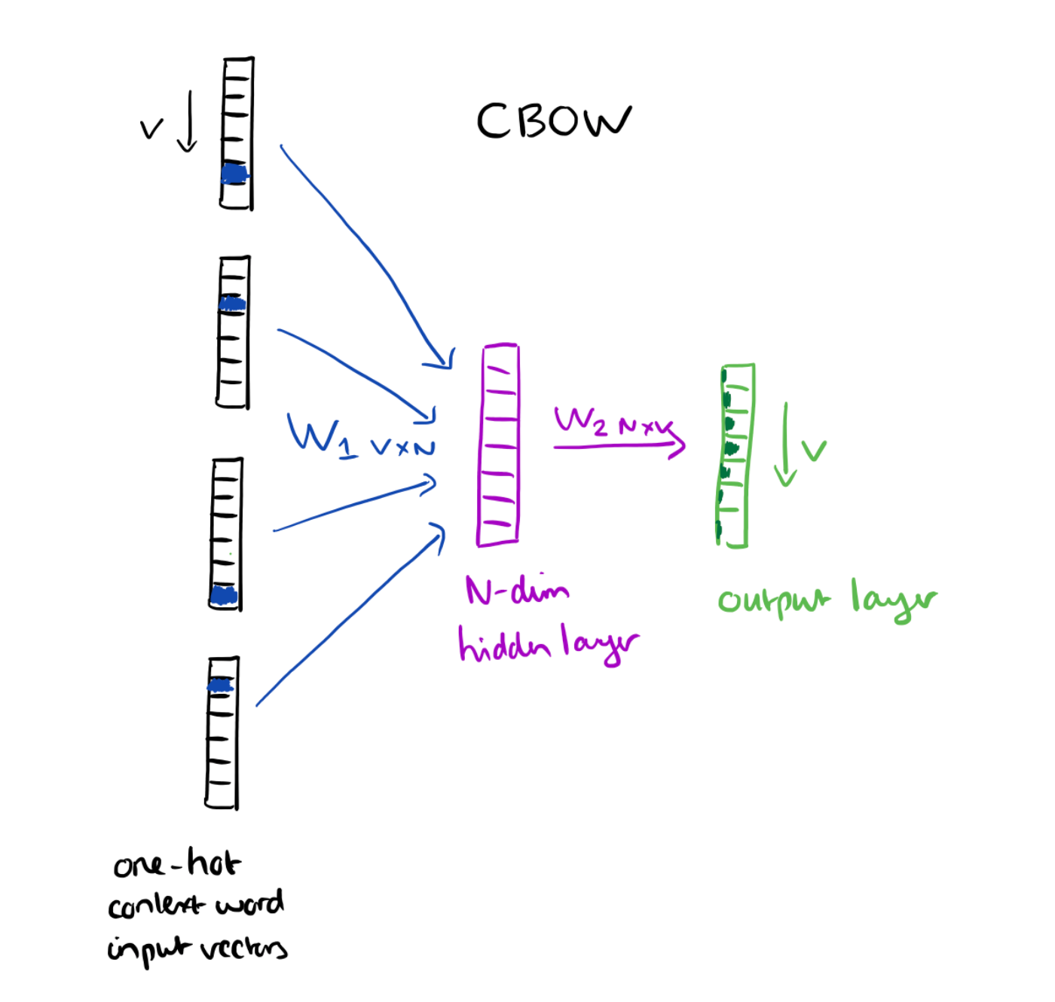

Word2Vec - CBOW
Adrian Colyer, The amazing power of word vectors, https://blog.acolyer.org/2016/04/21/the-amazing-power-of-word-vectors/

Slide 36
Word2Vec – Skip-gram
The training objective is to mimimise the summed prediction error across all context words in the output layer.
In the example, the input would be “learning”, and we hope to see (“an”, “efficient”, “method”, “for”, “high”, “quality”, “distributed”, “vector”) at the output layer.
Adrian Colyer, The amazing power of word vectors, https://blog.acolyer.org/2016/04/21/the-amazing-power-of-word-vectors/

Slide 37
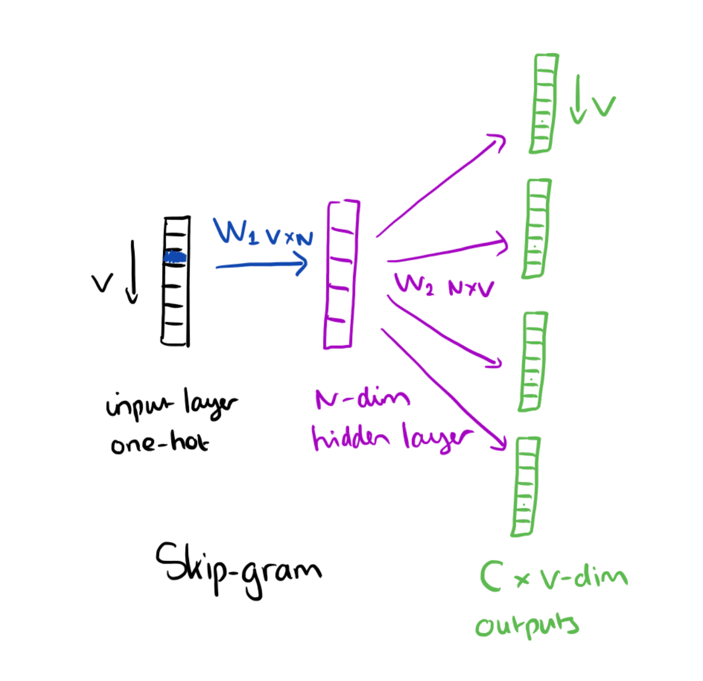

Word2Vec – Skip-gram
Adrian Colyer, The amazing power of word vectors, https://blog.acolyer.org/2016/04/21/the-amazing-power-of-word-vectors/

Slide 38
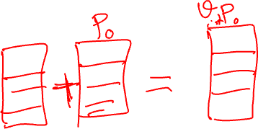
Positional encoding

Slide 39
Embedding with positional encoding

Slide 40


Positional encoding – sinusoidal
- “pos” is the position of the “word” in the sequence.
- P0 refers to the position embedding of the first word;
- “d” is the size of the word/token embedding.
- In this example d=5.
- While “d” is fixed, “pos” and “i” vary.
From Visual Guide to Transformer Neural Networks - (Part 1) Position Embeddings via:
https://datascience.stackexchange.com/questions/51065/what-is-the-positional-encoding-in-the-transformer-model

Slide 41


Positional encoding- sinusoidal – the effect of “pos”
From Visual Guide to Transformer Neural Networks - (Part 1) Position Embeddings via:
https://datascience.stackexchange.com/questions/51065/what-is-the-positional-encoding-in-the-transformer-model

Slide 42

Positional encoding- sinusoidal – the effect of “i”
If you vary “i” in the equation above, you will get a bunch of curves with varying frequencies. Reading off the position embedding values against different frequencies, lands up giving different values at different embedding dimensions for P0 and P6.
From Visual Guide to Transformer Neural Networks - (Part 1) Position Embeddings via:
https://datascience.stackexchange.com/questions/51065/what-is-the-positional-encoding-in-the-transformer-model

Slide 43


Positional encoding- sine/cosine

Slide 44


Scaled dot product self-attention
The dot products in the attention computation can have large magnitudes and move the arguments to the softmax function into a region where the largest value completely dominates.
Small changes to the inputs to the softmax function now have little effect on the output (i.e., the gradients are very small), making the model difficult to train.
To prevent this, the dot products are scaled by the square root of the dimension Dq of the queries and keys.

Slide 45

Multi-head attention
Understanding Deep Learning, Simon J.D. Prince, MIT Press.

Slide 46
Transformer layers
Self-attention is just one part of a larger transformer layer. This consists of a multi-head self-attention unit (which allows the word representations to interact with each other) followed by a fully connected network mlp[x•] (that operates separately on each word).
Both units are residual networks (i.e., their output is added back to the original input).
In addition, it is typical to add a LayerNorm operation after both the self-attention and fully connected networks.
This is similar to BatchNorm but uses statistics across the tokens within a single input sequence to perform the normalization.
Understanding Deep Learning, Simon J.D. Prince, MIT Press.

Slide 47



Transformer layers
Understanding Deep Learning, Simon J.D. Prince, MIT Press.

Slide 48

Transformers in practice
https://transformer.huggingface.co

Slide 49




Slide 50

Tokenisation
A text processing pipeline begins with a tokenizer. This splits the text into a vocabulary of smaller constituent units (tokens) that the subsequent network can process.
In the discussion above, we have implied that these tokens represent words, but there are several difficulties.

Slide 51
Tokenisation
Inevitably, some words (e.g., names) will not be in the vocabulary.
It’s unclear how to handle punctuation, but this is important. If a sentence ends in a question mark, we must encode this information.
The vocabulary would need different tokens for versions of the same word with different suffixes (e.g., walk, walks, walked, walking), and there is no way to clarify that these variations are related.

Slide 52




Embeddings
Each token in the vocabulary $𝒱$ is mapped to a word embedding.
Notably, the same token always maps to the same embedding. To accomplish this, the N input tokens are encoded in the matrix $T∈R^{𝒟×\left|𝒱\right|}$, where the nth column corresponds to the nth token and is a $\left|𝒱\right|×1$ one-hot vector (i.e., a vector where every entry is zero except for the entry corresponding to the token, which is set to one).

Slide 53


Input embeddings
The input embeddings are computed as $X=Ω_{e}$, and $Ω_{e}$ is learned like any other network parameter.
A typical embedding size $𝒟$ is 1024, and a typical total vocabulary size $\left|𝒱\right|$ is 30,000, so even before the main network, there are many parameters in $Ω_{e}$ to learn.

Slide 54


Embeddings
Understanding Deep Learning, Simon J.D. Prince, MIT Press.

Slide 55

Transformer model
The embedding matrix X is passed through a series of transformer layers, called a transformer model.
There are three types of transformer models.
An encoder transforms the text into a representation that can support a variety of tasks.
A decoder generates a new token that continues the input text.
Encoder-decoders are used in sequence-to-sequence tasks, where one text string is converted into another (e.g., machine translation).

Slide 56


BERT model
BERT is an encoder model that uses a vocabulary of 30,000 tokens. Input tokens are converted to 1024-dimensional word embeddings and passed through 24 transformer layers.
Each contains a self-attention mechanism with 16 heads. The queries, keys, and values for each head are of dimension 64 (i.e., the matrices $Ωvh,Ωqh,Ωkh$are $1024×64$).
The dimension of the hidden layer in the neural network layer of the transformer is 4096.
The total number of parameters is ∼ 340 million.

Slide 57

BERT
Encoder models like BERT exploit transfer learning.
During pretraining, the parameters of the transformer architecture are learned using self-supervision from a large corpus of text.
The goal here is for the model to learn general information about the statistics of language.
In the fine-tuning stage, the resulting network is adapted to solve a particular task using a smaller body of supervised training data.

Slide 58

Pre-training
In the pre-training stage, the network is trained using self-supervision. This allows the use of enormous amounts of data without the need for manual labels.
For BERT, the self supervision task consists of predicting missing words from sentences from a large internet corpus.
During training, the maximum input length is 512 tokens, and the batch size is 256.
The system is trained for a million steps, corresponding to roughly 50 epochs of the 3.3-billion word corpus.

Slide 59


BERT
Understanding Deep Learning, Simon J.D. Prince, MIT Press.

Slide 60

Pre-training – predicting missing words
Predicting missing words forces the transformer network to understand some syntax.
For example, it might learn that the adjective red is often found before nouns like house or car but never before a verb like shout.
It also allows the model to learn superficial common sense about the world. For example, after training, the model will assign a higher probability to the missing word train in the sentence The <mask> pulled into the station than it would to the word peanut. However, the degree of “understanding” this type of model can ever have is limited.

Slide 61
Pre-training – predicting adjunct sentences
BERT also uses a secondary task that predicts whether two sentences were originally adjacent in the text or not, but this only marginally improves performance.

Slide 62
Fining tuning
In the fine-tuning stage, the model parameters are adjusted to specialise the network to a particular task (e.g. sentiment analysis, named entity recognition).
An extra layer is appended onto the transformer network to convert the output vectors to the desired output format.

Slide 63


Fine tuning BERT- examples
Understanding Deep Learning, Simon J.D. Prince, MIT Press.

Slide 64
Decoder model example: GPT3
The basic architecture is very similar to the encoder model and comprises a series of transformer layers that operate on learned word embeddings.
However, the goal is different. The encoder aimed to build a representation of the text that could be fine-tuned to solve a variety of more specific NLP tasks.
Conversely, the decoder has one purpose: to generate the next token in a sequence.
It can generate a coherent text passage by feeding the extended sequence back into the model.

Slide 65

Language modelling
GPT3 constructs an autoregressive language model. This is easiest to understand with a concrete example. Consider the sentence It takes great courage to let yourself appear weak.
For simplicity, let’s assume that the tokens are the full words.
The probability of the full sentence is:
Understanding Deep Learning, Simon J.D. Prince, MIT Press.

Slide 66



Autoregressive model
An autoregressive model factors the joint probability $Pr⁡(t1, t2, . . . , tN)$ of the $N$ observed tokens into an autoregressive sequence:
The autoregressive formulation demonstrates the connection between maximizing the log probability of the tokens in the loss function and the next token prediction task.

Slide 67
Masked self-attention
To train a decoder, we maximise the log probability of the input text under the autoregressive model.
Ideally, we would pass in the whole sentence and compute all the log probabilities and gradients simultaneously.
However, this poses a problem; if we pass in the full sentence, the term computing log [Pr(great|It takes)] has access to both the answer great and the right context courage to let yourself appear weak.
Hence, the system can cheat rather than learn to predict the following words, and will not train properly.

Slide 68
The decoder network
The input text is tokenised, and the tokens are converted to embeddings.
The embeddings are passed into the transformer network, but now the transformer layers use masked self-attention so that they can only attend to the current and previous tokens.
Each of the output embeddings can be thought of as representing a partial sentence, and for each, the goal is to predict the next token in the sequence.
Consequently, after the transformer layers, a linear layer maps each word embedding to the size of the vocabulary, followed by a softmax[•] function that converts these values to probabilities.
The aim is to maximise the sum of the log probabilities of the next token in the ground truth sequence at every position using a standard multiclass cross-entropy loss.

Slide 69


Training GPT-3 type decoder

Slide 70

The autoregressive language model
The autoregressive language model is the first example of a generative model. Since it defines a probability model over text sequences, it can be used to sample new examples of plausible text.
To generate from the model, we start with an input sequence of text (which might be just a special <start> token indicating the beginning of the sequence) and feed this into the network, which then outputs the probabilities over possible subsequent tokens.
We can then either pick the most likely token or sample from this probability distribution.
The new extended sequence can be fed back into the decoder network that outputs the probability distribution over the next token.
By repeating this process, we can generate large bodies of text.

Slide 71

Computation and choosing the output
The computation can be made quite efficient as prior embeddings do not depend on subsequent ones due to the masked self-attention. Hence, much of the earlier computation can be recycled as we generate subsequent tokens.
In practice, many strategies can make the output text more coherent. For example, beam search keeps track of multiple possible sentence completions to find the overall most likely (which is not necessarily found by greedily choosing the most likely next word at each step).
Top-k sampling randomly draws the next word from only the top-K most likely possibilities to prevent the system from accidentally choosing from the long tail of low-probability tokens and leading to an unnecessary linguistic dead end.

Slide 72

GPT-3 – the scale
GPT3 applies these ideas on a massive scale. The sequence lengths are 2048 tokens long, and since multiple spans of 2048 tokens are processed at once, the total batch size is 3.2 million tokens.
There are 96 transformer layers (some of which implement a sparse version of attention), each processing a word embedding of size 12288. There are 96 heads in the self-attention layers, and the value, query, and key dimension is 128.
It is trained with 300 billion tokens and contains 175 billion parameters.

Slide 73
Encoder-decoder example- machine translation
Translation between languages is an example of a sequence-to-sequence task.
This requires an encoder (to compute a good representation of the source sentence) and a decoder (to generate the sentence in the target language).
This task can be tackled using an encoder-decoder model.

Slide 74
Machine translation
Consider the example of translating from English to French.
The encoder receives the in English and processes it through a series of transformer layers to create an output representation for each token.
During training, the decoder receives the ground truth translation in French and passes it through a series of transformer layers that use masked self-attention and predict the following word at each position.
However, the decoder layers also attend to the output of the encoder. Consequently, each French output word is conditioned on the previous output words and the entire English sentence it is translating

Slide 75

Encoder-decoder architecture

Slide 76
Encoder-decoder attention (Cross attention)
The original transformer layer in the decoder consists of a masked self-attention layer followed by a neural network applied individually to each embedding.
A new self-attention layer is added between these two components, in which the decoder embeddings attend to the encoder embeddings.
This uses a version of self-attention known as encoder-decoder attention or cross-attention, where the queries are computed from the decoder embeddings and the keys and values from the encoder embeddings.

Slide 77


Cross attention

Slide 78

Masked Generative Transformers
Huiwen Chng et al., Muse: Text-To-Image Generation via Masked Generative Transformers, Google Research
https://muse-model.github.io

Slide 79
Acknowledgements
The main content are adapted from: Chapter 18, Understanding Deep Learning, Simon J.D. Prince, to be published by MIT Press.
Some slides/images are also adapted from the excellent tutorial at Hedu youtube Channel: https://www.youtube.com/@HeduMathematicsofIntelligence/playlists

Slide 80
If you have any questions
Please feel free to come and see me (9th Floor, Sir Michael Uren Research Hub, White City Campus) or email (p.barnaghi@imperial.ac.uk).

